Slide 1
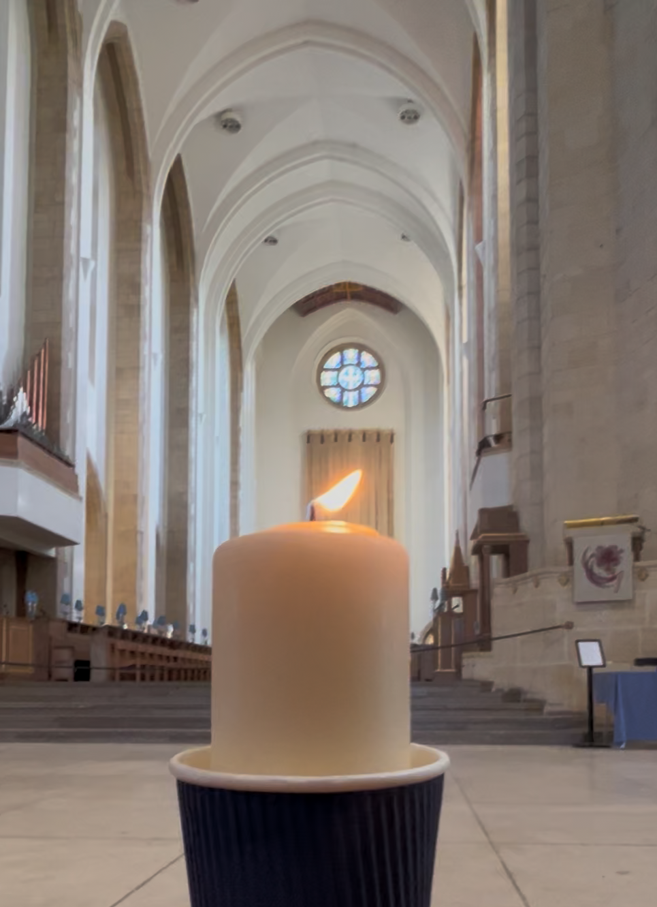

Notes:
Slide 1: Flickering Leavers’ Candle in Guildford Cathedral slide
As you begin, you might want to be still with your own thoughts or prayers for a few moments….

Slide 2
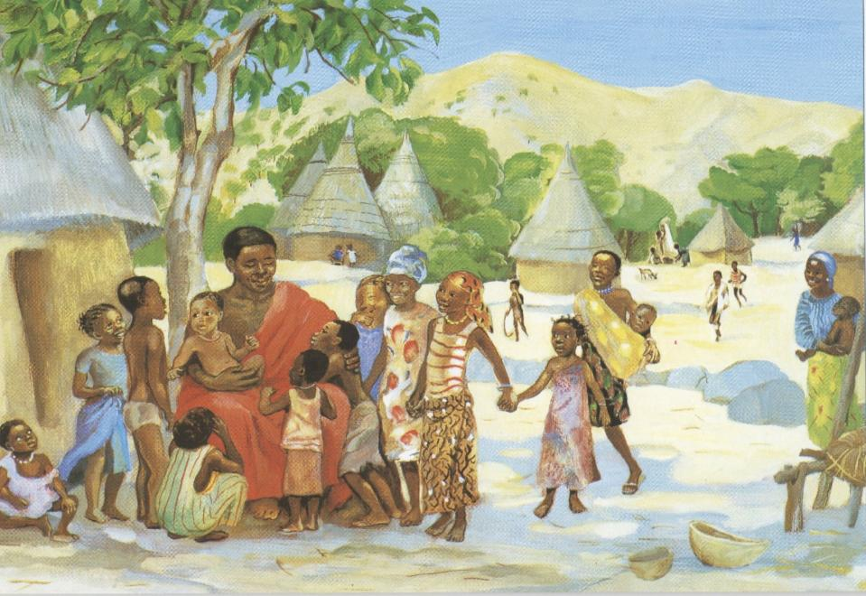
Image © Jesus MAFA, from Vanderbilt Library
Notes:
Slide 2: Before you start with the specifics of filling in the form or gathering children's responses, you might like to use this slide with children to get them thinking....
The Bible tells a story (Matthew 19:13-15) of how Jesus stopped to welcome and spend time with children, when the disciples wanted to get on with their work.
Jesus said that children are important to God.
We want our new Bishop to be someone who welcomes everyone, including children. I wonder how our new Bishop might especially show children that they matter – to them and to God?
[Spend a few minutes talking about this, as it will help children with the questions later]

Slide 3

Video by Bishop Paul
YouTube Link
Notes:
In this short video Bishop Paul who is our Acting Bishop Asks the children for their help.
https://youtu.be/VX3flNB5ffY?si=KTAQPqpXUxcPJ55G

Slide 4
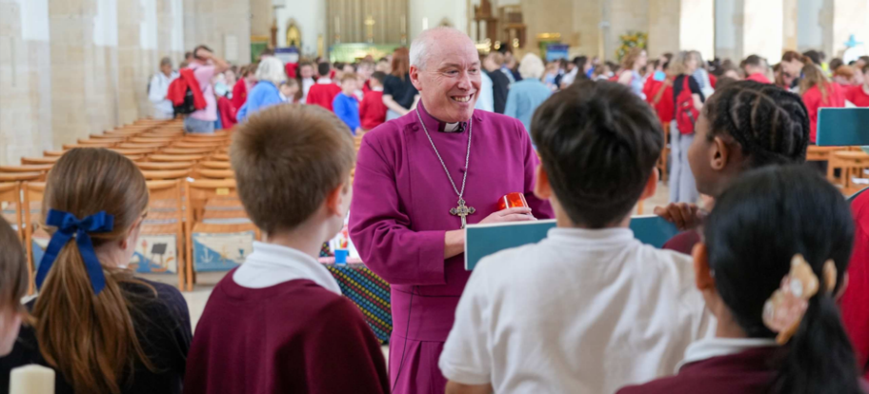
What do you think?
Notes:
NB Adults, there are further resources, including a video from Bishop Paul inviting children to respond and to help you to consider your ideas or gather children’s responses! These are on the Guildford Diocese ‘Vacancy in See’ webpage.
Slide 2: What do you think?
We are asking children and young people for their ideas about what our new Bishop should be like, so here are a few thoughts to reflect on….
What do you think should be in the new Bishop’s heart?
What should they carry in their backpack to help in their work?
What would they pray about?
If the Bishop has visited your school or church, how would you finish the sentence…?
When the Bishop visited, I liked……
If the Bishop hasn’t visited your school or church, how would you finish the sentence…?
I like it in collective worship (or assembly) when we……

Slide 5
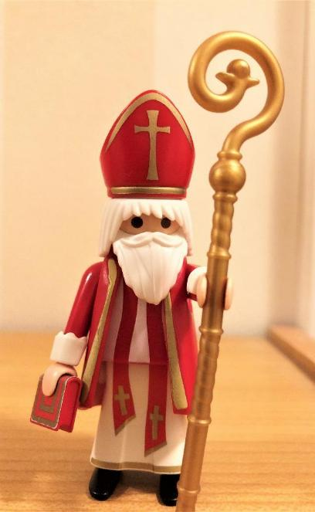
We will share your ideas with vicars who are thinking about being our new bishop.
Notes:
Slide 3: How we will use your ideas
We will gather your ideas and use them to tell vicars who are thinking about applying to be our new bishop what the children in our diocese are hoping they will care about.

Slide 6
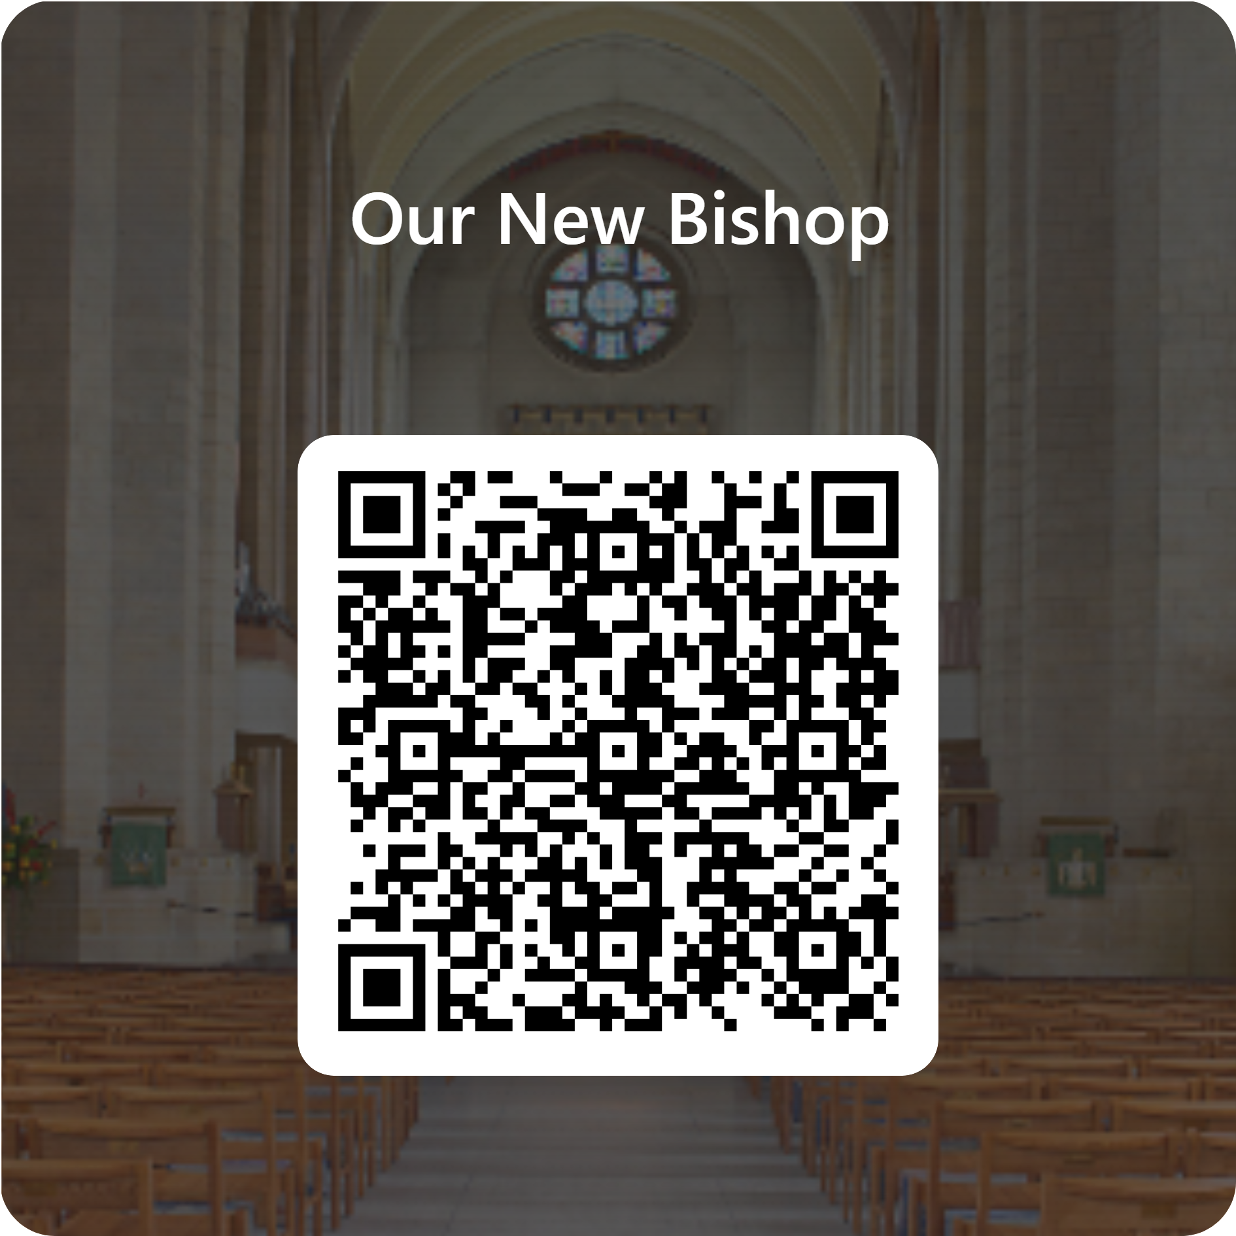
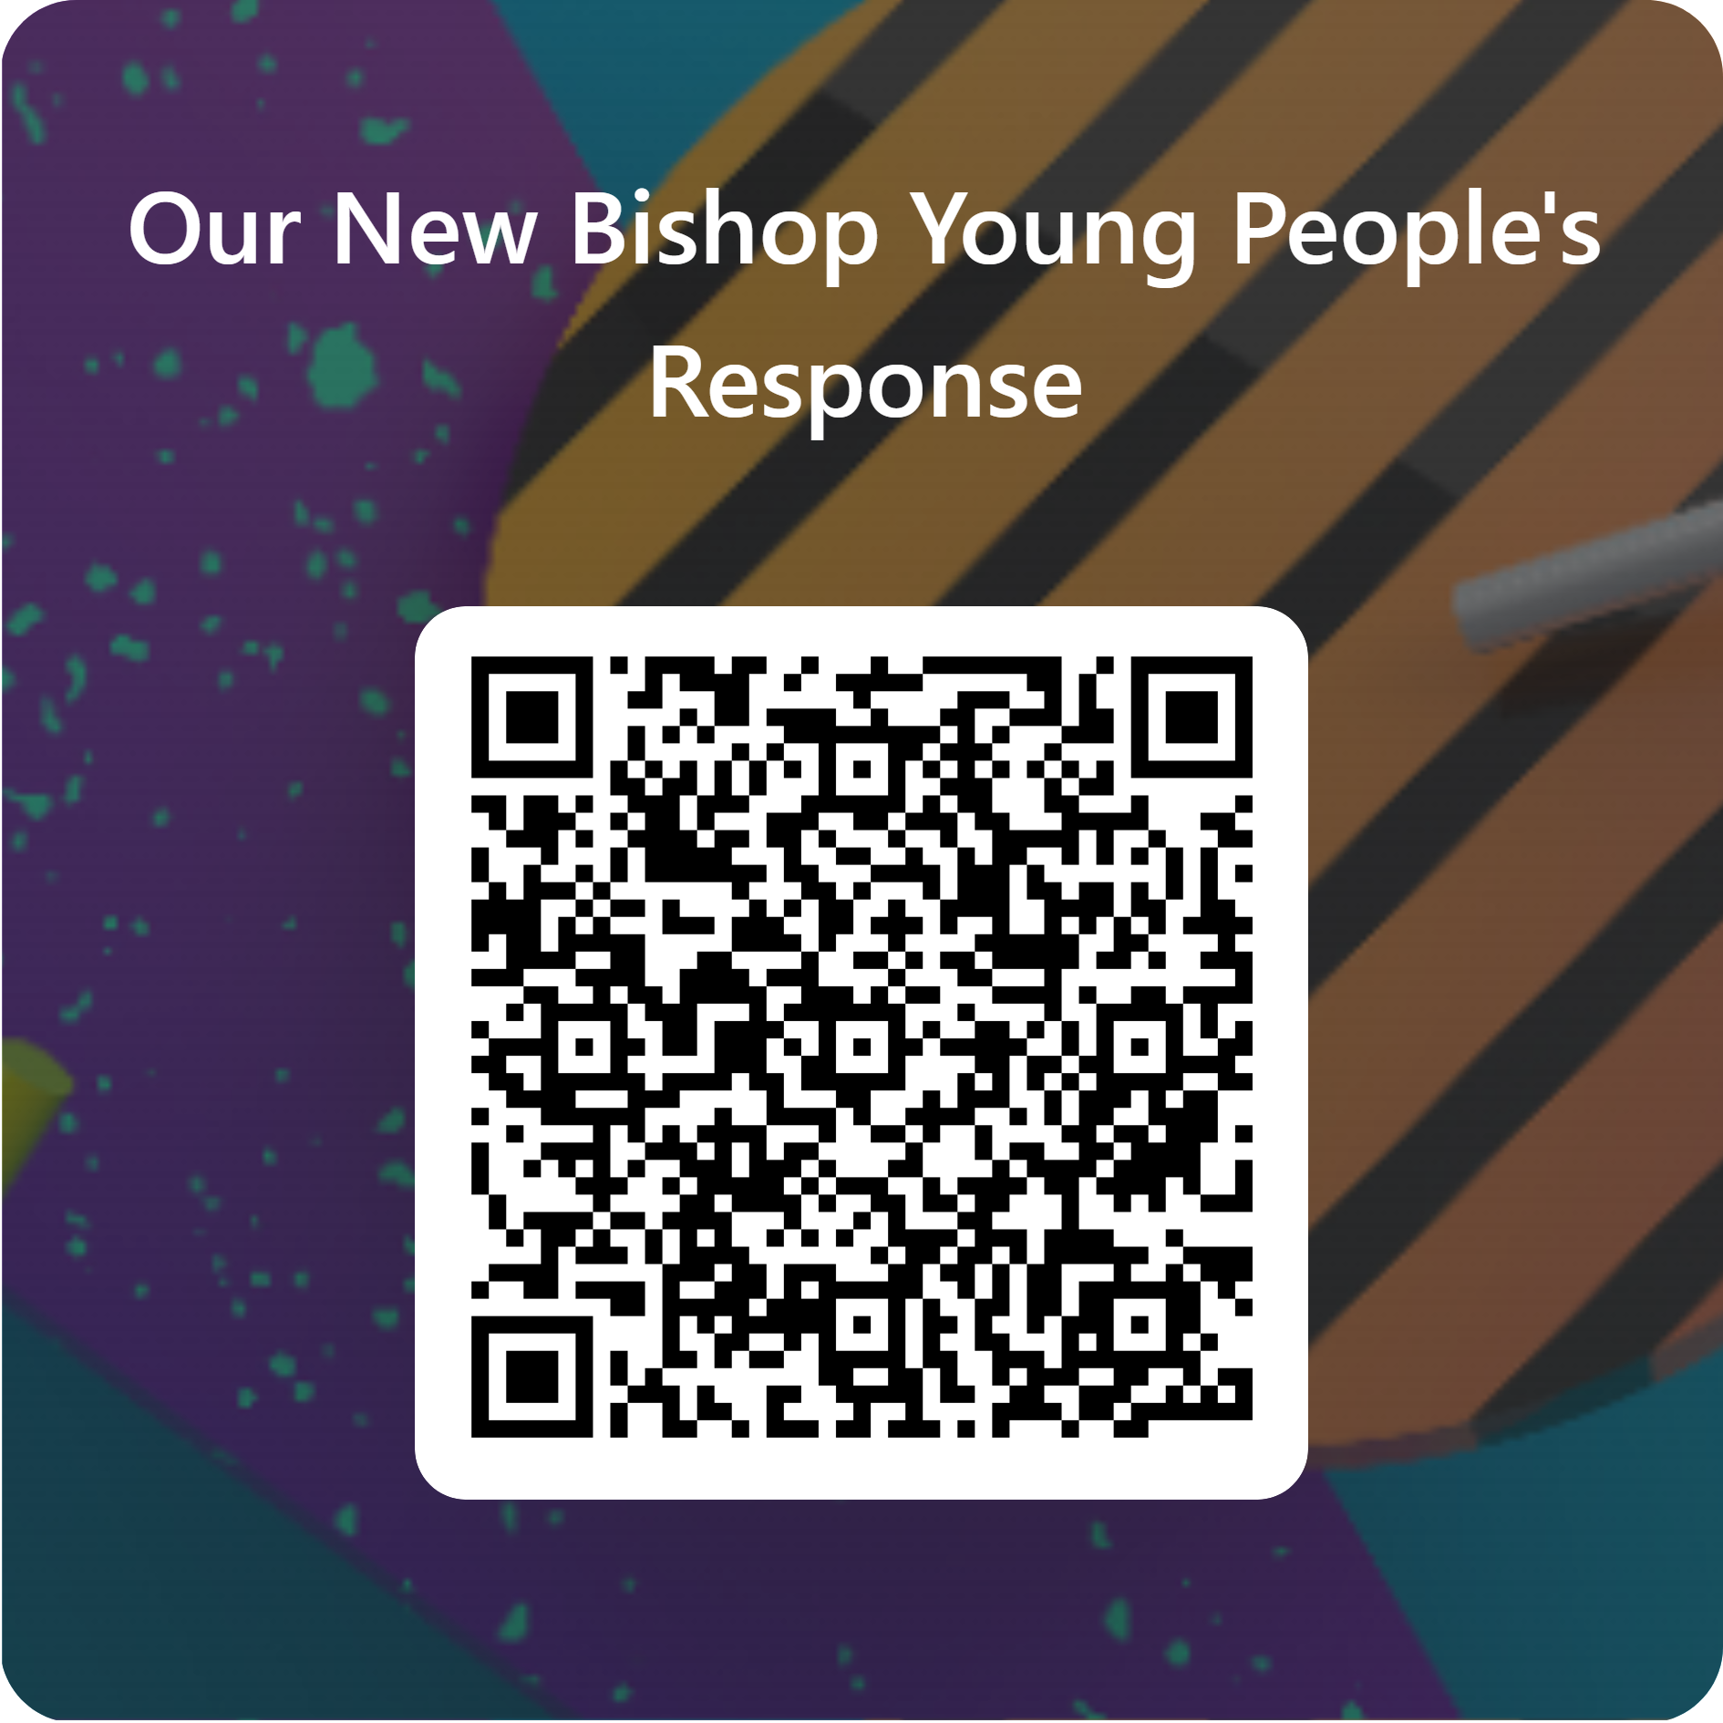

Age 13 and under use this form.
14 and older use this form.
Notes:
Slide 6
You could respond by writing or drawing your answers onto the printed sheet.
You could type your answers into this form.
You could talk about your thoughts as a group and an adult could type them onto this form.
There is a different version of the online form for young people age 14 and above. See the different QR code

Slide 7
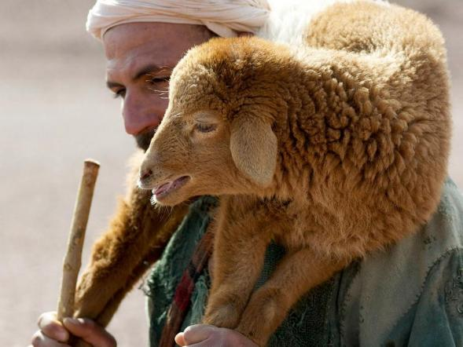
O God, who gives wisdom to all who ask,
We are grateful for all those who lead us…. in our schools….our churches…..our community….and our wider world…..and especially now, as we pray for whoever will be our new Bishop.
Please guide their thoughts and their hearts as they respond to your call to shepherd this flock in the Diocese of Guildford.
Notes:
Slide 7: Prayer
Here is a prayer to use, if you would like to, after you have thought about all these ideas.
O God, who gives wisdom to all who ask,
We are grateful for all those who lead us…. in our schools….our churches…..our community….and our wider world…..and especially now, as we pray for whoever will be our new Bishop.
Please guide their thoughts and their hearts as they respond to your call to shepherd this flock in the Diocese of Guildford.

Slide 8


